Slide 1
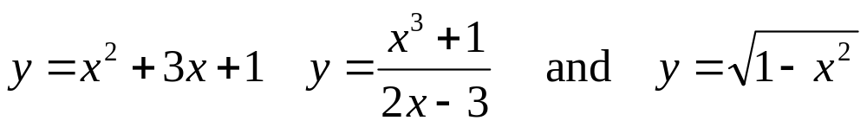
Section 2.8 Implicit Differentiation（隐函数求导） and Inverse Trigonometric Functions
So far the functions have all been given by equations of the form y=f(x). A function in this form is said to be in explicit form. For example, the functions
are all functions in explicit form（显函数表达）.
Sometimes practical problems will lead to equations in which the function y is not written explicitly in terms of the independent variable x. For example, the equations such as
are said to be in implicit form（隐函数表达）.

Slide 2
Implicit Differentiation: Suppose an equation defines
y implicitly as a differentiable function of x. To find
df/dx
Differentiate both sides of equation with respect to x.
remember that y is really a function of x and use the
chain rule when differentiating terms containing y.
2. Solve the differentiated equation algebraically for
dy/dx.

Slide 3
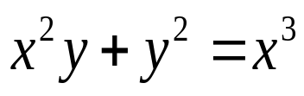

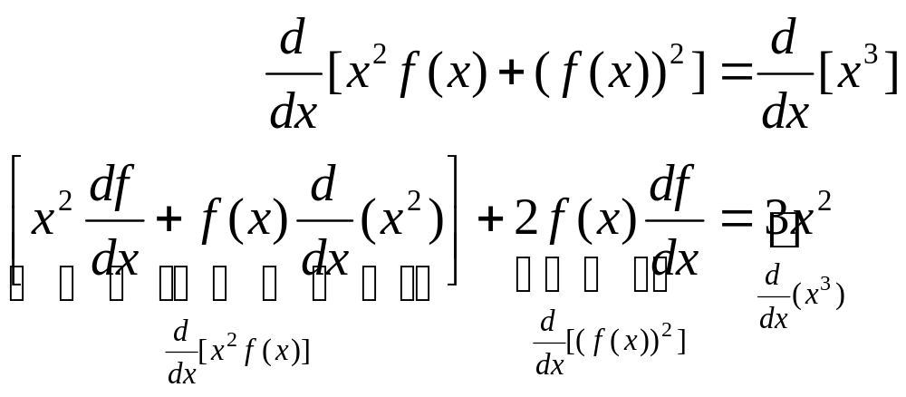
Example
Find dy/dx if
Solution:
We are going to differentiate both sides of the given equation with respect to x. Firstly, we temporarily replace y by f(x) and rewrite the equation as . Secondly, we differentiate both sides of this equation term by term with respect to x:
To be continued

Slide 4
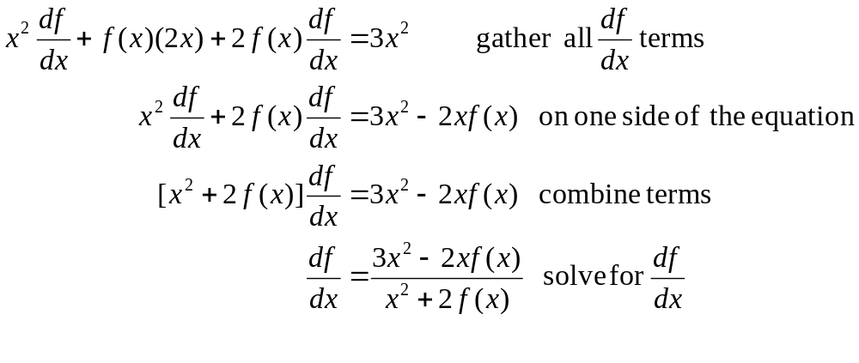
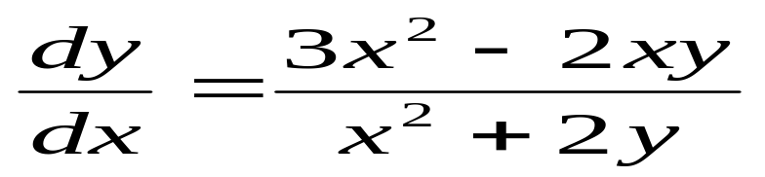
Thus, we have
Finally, replace f(x) by y to get

Slide 5

Exercise
Find dy/dx by implicit differentiation where

Slide 6

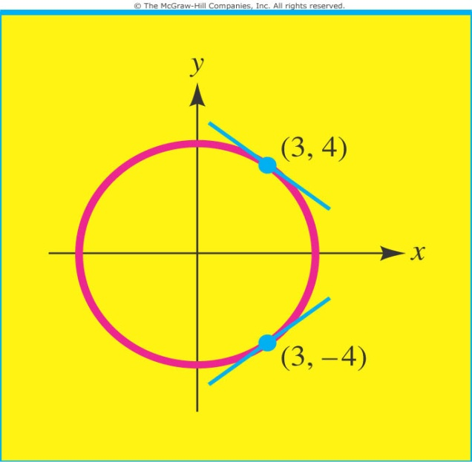
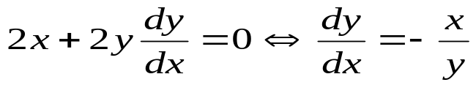
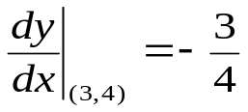
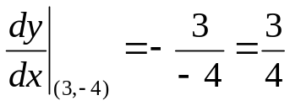
Computing the slope of a tangent line by implicit differentiation
Example 27
Find the slope of the tangent line to the circle at the point (3,4). What is the slope at the point (3,-4)?
Solution:
Differentiating both sides of the equation with respect to x, we have
Thus, the slope at (3,4) is
The slope at (3,-4) is

Slide 7
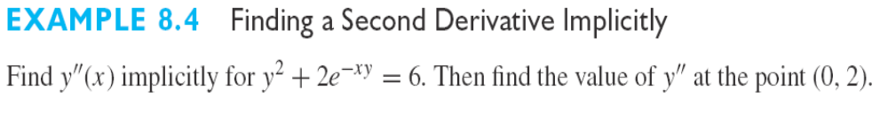
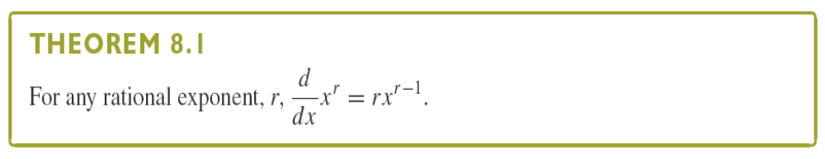

Slide 8
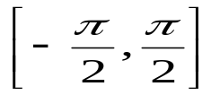
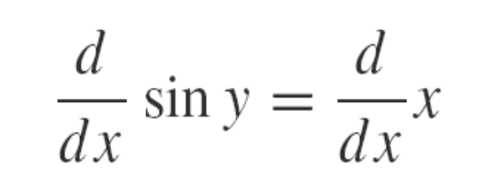
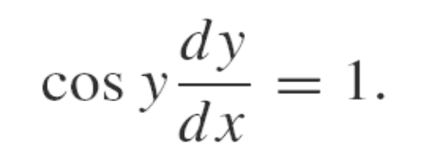
Derivatives of the Inverse Trigonometric Functions （反三角函数求导）
The inverse sine (or arcsine) function is defined by restricting the domain of the sine function to the interval . Specifically, we have
Differentiating the equation siny=x implicitly, we have
and so,

Slide 9
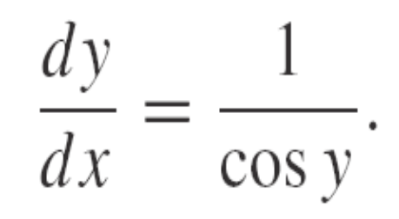
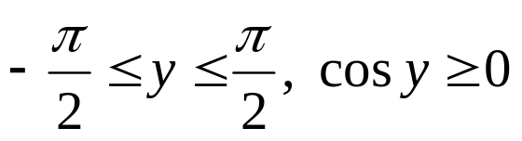
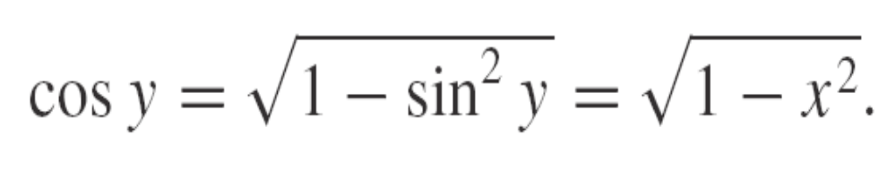
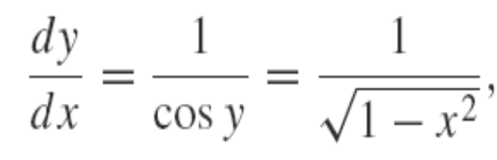
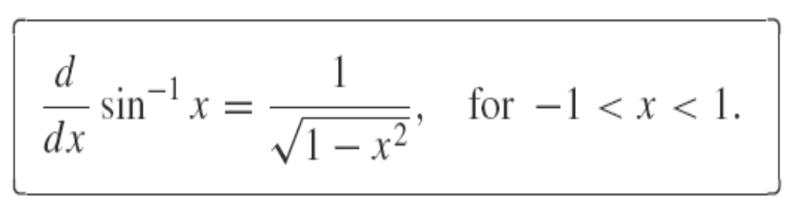
Solving this for dy/dx, we find (for cosy≠0) that
Notice that for and hence,
This leaves us with
for -1<x<1. That is,

Slide 10
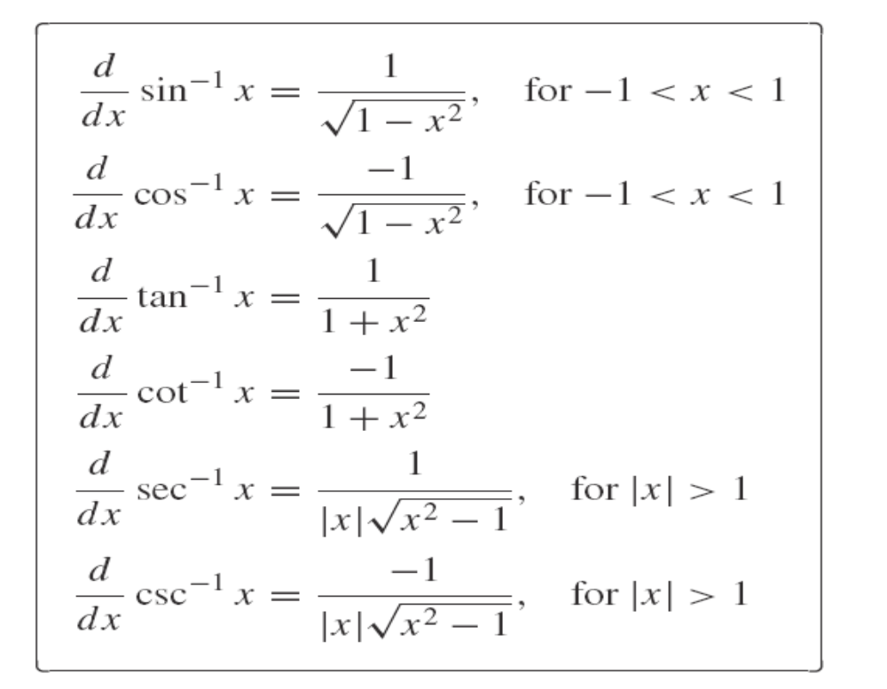

Slide 11
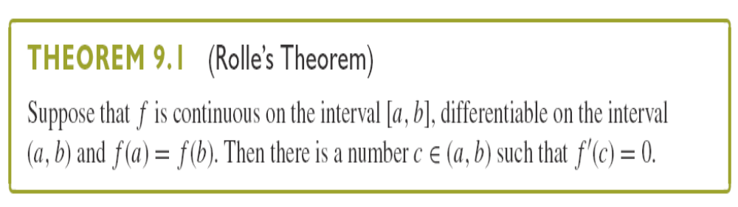
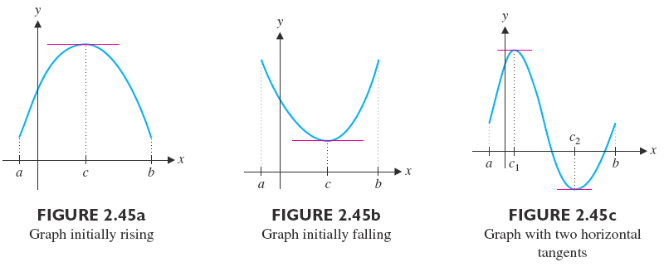
Section 2.9 The Mean Value Theorem (中值定理)

Slide 12
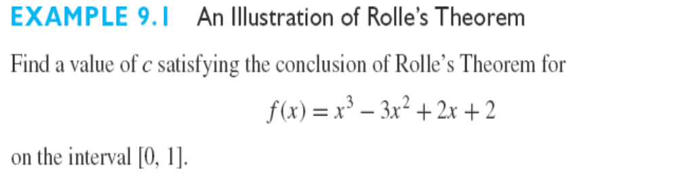
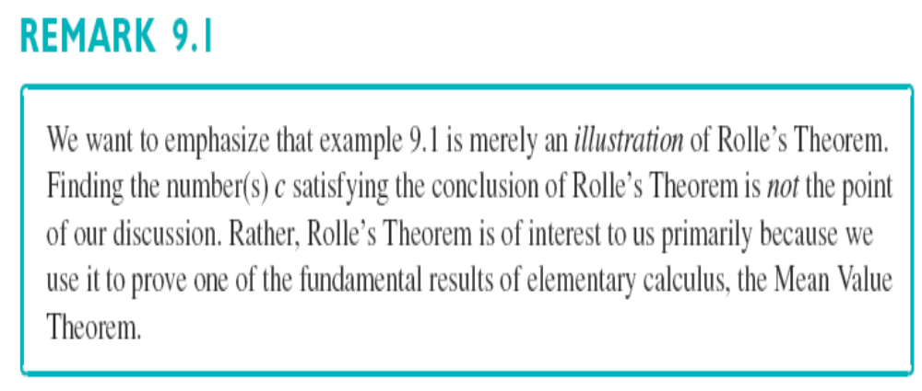

Slide 13
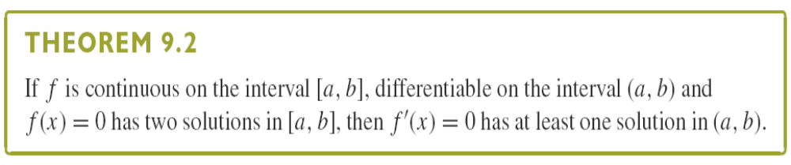
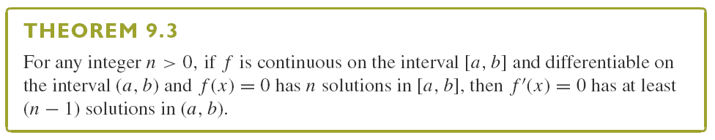
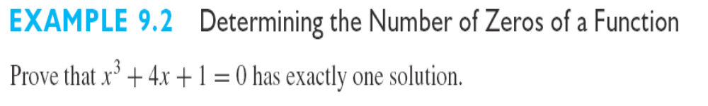
Rolle’s Theorem can be helpful to determine how many zeros a given function has.

Slide 14
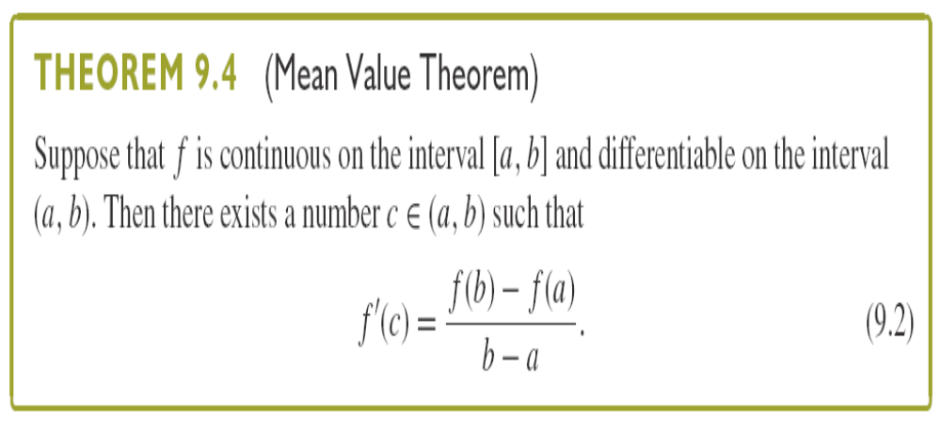
We now generalize Rolle’s Theorem to one of the most significant results of elementary calculus.

Slide 15
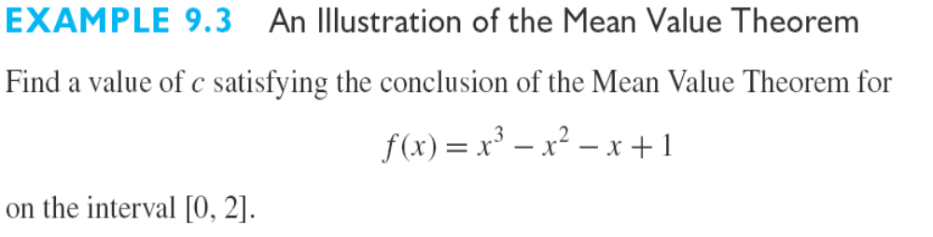
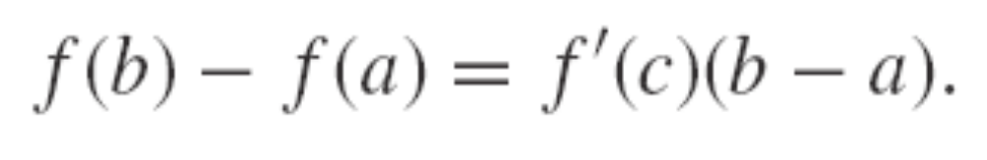
Remark: The existence of c is not point of the theorem. In fact, these c’s usually remain unknown. The significance of the Mean Value Theorem is that is relates a difference of function values to the difference of the corresponding x-values, that is,

Slide 16
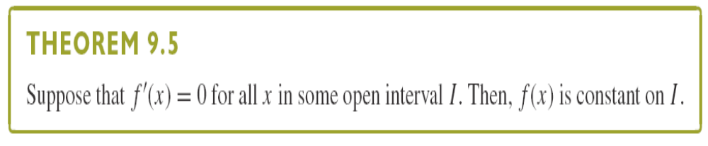
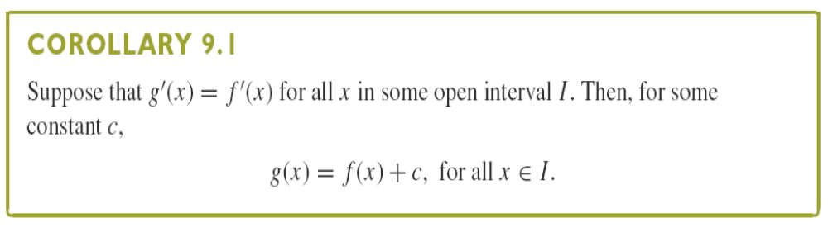
Recall that for any constant c, dc/dx=0.
A question that you probably haven’t thought to ask is: Are there any other functions whose derivative is zero?

Slide 17
